Slide 1






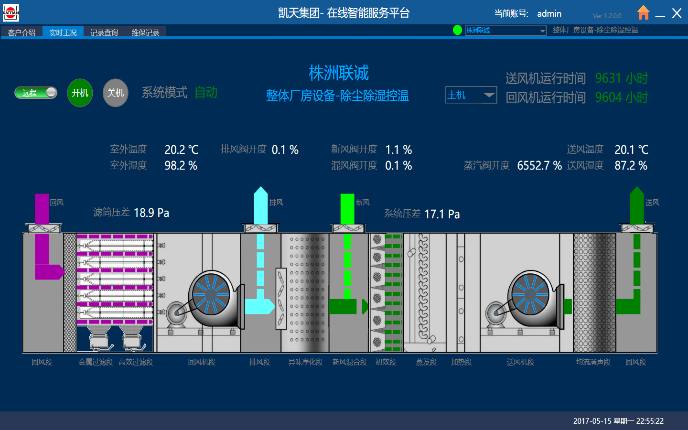
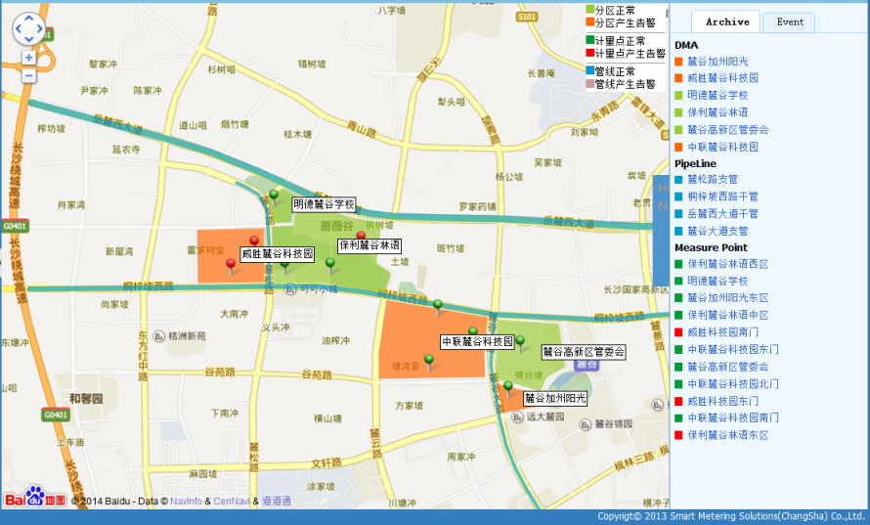
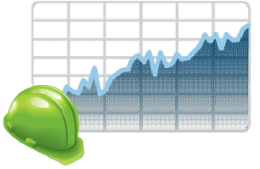










AMI Architecture
CIS / ERP / SAP
Prepay
Third System
IEC 61968 / Web Service / JSON
MDM
Data Analysis
Data
Report
Business Application
Data Storage
HES
Device
Adapter
Data
Collection
Communication
Security
Provisioning
Device
Configuration
WAN
WAN / GPRS / 3G / 4G / VPN
Data Security
DCU
DCU
Gateway
GPRS Module
LAN
PLC / RF / RS232 / RS485 / Zigbee / WIFI
Metering
Electricity Meter
Gas Meter
Watar Meter
Heat Meter
Infrastructure
SMART TRANSMISSION
SMART DISTRIBUTION
RAIL & MICROGRIDS

Slide 2
UDIS Key Functions
System Integration
Provisioning – Add / Remove / replace
Meter Data Reads
Meter Event / Alarm Reads
On Demand Reads
Meter Configuration (Get / Set)
Connect / Disconnect
Asset MGR – Meter / DCU ……
Deployment & Cluster MGR
Meter Group MGR
Meter RAW Data Report
Collection Schedule MGR
Meter Configuration – TOU / Load Limit ……
Application
Firmware MGR & Upgrade
DCU Configuration
Time synchronization
Meter Data / Event Collection
On Demand Reads
Connect / Disconnect
Integrity Report
Operation Monitor
Log System
Device Integration
Meter Protocol Adapter
DCU Protocol Adapter
Communication Support
Communication Security

Slide 3
UDIS Component Architecture
UDIS
Third System
Application Sub System
Integration Sub Sys.
MDM
Asset MGR
Firmware MGR
Data Report
RCS
Third System
Meter Configuration
On Demand Reads
Schedule MGR
DDS
Devices
Cluster MGR
Integrity Report
…………
Standards
Meter
AMR Sub System
UAA
Meter
Collection (x)
FEE (x)
Router
Router Adapter
Meter
Alarm
Other Plugin
IDIS
DCU
ANSI
DCU
Operation Sub System
DSMR
WD
Cluster MGR
Gateway

Slide 4
UDIS Layer Model
Express Model
Logic Model
Message Bus
Comm. Model
Terminal Model
Meter Model
Collection
E-Meter
UDIS UI
DCU
Alarm
W-Meter
MDM
Router
FEE（X）
GW
RCS
G-Meter
Third System
GPRS Module
Other Plugin
H-Meter
Data Collection (new type)
Third System (new) type
New System
Adapter
New Device
Adapter
FEE( new type)
Terminal (new type)
Meter (new type)
RCS
Notes:
UDIS 采用微服务架构模型，使得功能和性能上都得到良好的扩展性
Meter Model: 定义了与计量相关的模型，如TOU, Load Limit，kwh, kVarh …..
Terminal model: 定义了通讯方式及通讯协议，以及设备通讯并发控制
Comm. Model: 主要解决传输层之下的逻辑控制与设备建立通讯通道
Message Bus: 解决Cluster, 微服务之间消息总线
Logic Model: 解决协议应用层之上逻辑控制，业务流
Express Model: 解决人机交互逻辑
功能扩展：可以在任意层扩充微服务
性能扩展：可以在部署时候扩展服务器，微服务实例来完成

Slide 5
UDIS Layer Model
Express Model
Logic Model
Message Bus
Comm. Model
Terminal Model
Meter Model
Collection
E-Meter
UDIS UI
DCU
Alarm
W-Meter
MDM
Router
FEE（X）
GW
RCS
G-Meter
Third System
GPRS Module
Other Plugin
H-Meter
Logic Module (new instance)
Connection
Terminal (new instance)
Meter (new instance)
Task Pool
Business Session
FEE (new instance)
Terminal (new instance)
Meter (new instance)
Terminal (new instance)
Meter (new instance)

Slide 6
UDIS Technical Architecture
Electrical
EMS
Water
OS
Industry
Projectization
Platform
Project Data Model
Customized Applications
Customization
Project Script Development
Project Configuration Unities
ECLIPSE,VS2012/ Git,CVS/EA,VISIO / Jenkins/PC-Lint
Productization Platform
RCS
Collection (x)
FWU (x)
FEE (x)
Brand / Packaging
Router
Meter Configuration
On Demand Reads
Integrity Report
Core Protocol Packet library
Core Protocol Module
Task Generator Module
Database Access Module
Core Development Platform
Communicate Channel Module
Log Module
Task Scheduler Module
Archives Management Module
Performance / Core
Common library
Platform Configuration Unities
Task Factory Module
Database Storage Module
Struts/Spring
FreeMarker
Extjs6 Chart/ECharts
JDBC/OTL4/OCI
Cryptopp 562
Open Source Frameworks
JQuery
Axis2
Ajax
dhtmlxSuite/dhtmlxGrid
Openssl 1.0.2
Technical Platform
ASIO
log4j
CXF
gSoap2.8.15
JUnit4/VS UnitTest
JDK
BOOST 1.6.2

Slide 7
UDIS Deployment Model
UDIS
Devices
Server Node 【1】
Meter [MID]
Third System
FEE (x) [1]
Collection (x) [3]
Router [5]
Meter [MID]
MDM
FEE (x) [2]
Collection (x) [4]
RCS [6]
DCU [TID]
Third System
DDS
Application
DCU [TID]
Database
Gateway [TID]
Server Node 【NID】
1
*
Service [SID]
1
*
Meter [MID]
Terminal [TID]
Third System
Application
Collection
GPRS Meter
MDM
RCS
Router
FEE
DCU
Meter
Third System
Gateway
Meter
DDS

Slide 8
UDIS Cluster Deployment
UDIS
Devices
Collection Cluster
Message Bus. Cluster
Comm. Cluster
Server Node [5]
Meter
Server Node [4]
Server Node [1]
Collection (x) [5]
Router [4]
FEE (x) [1]
Meter
Server Node [6]
Third System
Server Node [4]
Collection (x) [6]
Devices
MDM
Router [4]
Server Node [2]
Meter
Third System
FEE (x) [2]
Application Cluster
RCS Cluster
Meter
Server Node [8]
Server Node [7]
Application
RCS 【7】
Server Node [3]
Devices
FEE (x) [3]
Server Node [8]
Gateway
Server Node [7]
Application
RCS 【7】
Gateway

Slide 9
UDIS HA
UDIS
Stateless Service Cluster
Collection (x)
FEE (x)
Collection (x)
FEE (x)
Devices
…………
WD
WD
WD
Meter
Collection (x)
FEE (x)
…………
Push Service Cluster
Meter
WD
WD
Alarm
WD
N + M
Meter
Alarm
WD
Web Service Cluster
Message Bus Cluster
DCU
Third System
Virtual IP / F5 / LVS
Application
RCS
Router
WD
DCU
MDM
WD
Router
WD
Gateway
MDM
Application
RCS
WD
Virtual IP / MQ
Web Logic / Tomcat

Slide 10
UDIS FEE Redundancy – Poll Model
Comm. Cluster
Devices
Server Node [1]
Meter[11]
FEE (x) [1]
Meter[12]
WD
Logic Layer
Devices
Server Node [2]
Collection
Message Bus Cluster
Server Node [2]
Meter[21]
FEE (x) [2]
WD
RCS
Meter [22]
Server Node [3]
FEE (x) [3]
Devices
WD
Gateway [31]
Standby
Server Node [x]
Gateway [32]
After FEE[1] crash, the FEE[x] will work, x -> 1
FEE(x) will be responsible for connecting with Meter[11], Meter[12]
FEE (x) [standby]
WD

Slide 11
UDIS FEE Redundancy – Push Model
Comm. Cluster
Devices
Server Node [1]
Meter[11]
FEE (x) [1]
Meter[12]
WD
Virtual IP / Cluster Gateway
Logic Layer
Devices
Collection
Message Bus Cluster
Server Node [2]
Meter[21]
Server Node [2]
RCS
FEE (x) [2]
WD
Meter [22]
Devices
Server Node [3]
Gateway [31]
Message Bus will storage the relationship between FEE and Device
Cluster Gateway (LVS, F5,WBL) will allocation connections from device dynamically,
FEE (x) [3]
WD
Gateway [32]

Slide 12
UDIS Task Pool
Task Pool
T[13]
T[11 ]
T[12 ]
T[11 ]
Task Slot [1]
Task Generator
T[24]
T[22]
T[23]
T[22]
T[21]
Task Slot [2]
Collection Schedule
Send
Message Pool
Task Factories
T[33]
T[31]
T[32]
T[31]
Task Slot [2]
T[n3]
T[n1]
T[n2]
T[n1]
Log Pool
Task Slot [n]
Count of Parallel, Configurable,
T: Task
n3: Terminal ID
Recv
Message Pool
1
*
Terminal
Task Slot

Slide 13
UDIS Task Model
Task Model
State - INIT
Recv
Message Pool
Message
Sent
Message
State - REQ
State - RESP
Received Message
Send
Message Pool
Finished Successfully
No Response
<= Retry Times
State - TMO
> Retry Times
State - DONE
Log Pool

Slide 14
UDIS Schedule Model
Task Scheme
Reference Time
*
Task Scheme [1]
Profile ID []1
Task Cycle
Freeze Cycle
Terminal Meter
*
1
Collection
Scheme
1
*
Task Scheme [2]
Task Scheme
Reference Time
*
Task Scheme [n]
Profile ID [n]
Task Cycle
Freeze Cycle

Slide 15
UDIS Schedule Model
Task Line
Task Cycle : 4 hours
Meter Data
Freeze Cycle : 1 hours
Profile progress : 1:00
Time Line
0
1
2
3
4
5
6
7
8
9
10
11
12
13
14
At 6:05, the network is not ready
At 10:05, the data (2:00 – 10:00) will be read
Task Line
Task Cycle : 4 hours
Meter Data
Freeze Cycle : 1 hours
Profile progress : 1:00
Time Line
0
1
2
3
4
5
6
7
8
9
10
11
12
13
14

Slide 16
UDIS UAA Model
MDM EIP
UDIS
RCS
Send Request Message
Meter Config (GET / SET)
Disconnect / Connect
Reply Response Message
On Demand Reads
Provisioning
CDC Status Check
FTP Servers
RCS
Meter RAW Data
Meter Event Data

